Slide 1


Slide 2


Slide 3


Slide 4


Slide 5
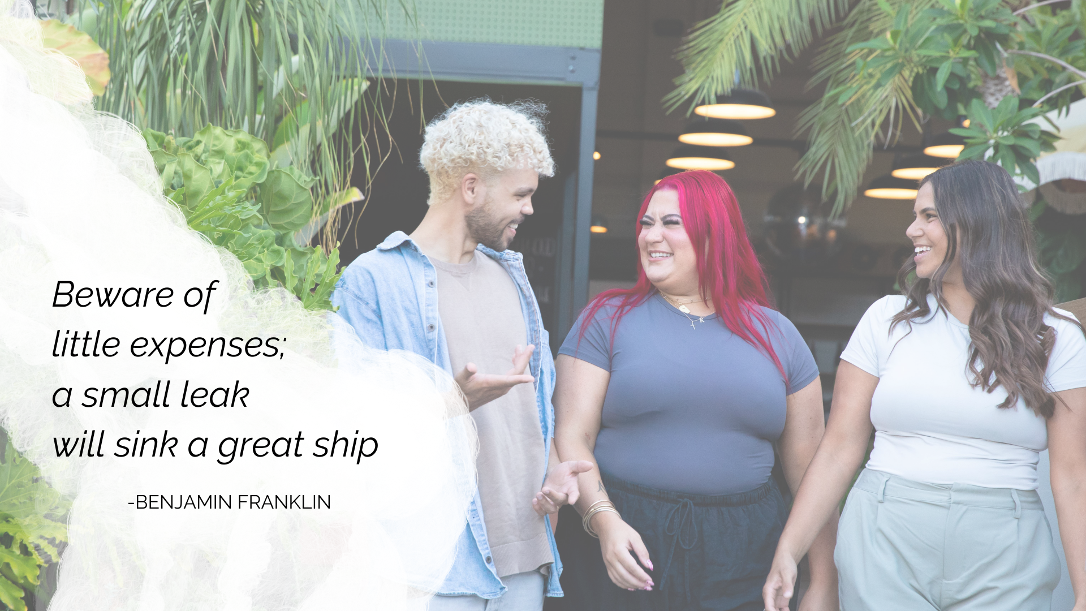

Slide 6


Slide 7

DATE | PURCHASE | COST
Mon 6th | Lunch | $12.50
 | Takeaway coffee | $4.50
Tue 7th | Lunch | $15.00
Wed 8th | Takeout dinner | $30.00
Thurs 9th | Public transport | $5.60
 | Lunch | $12.50
 | Kmart | $48.00
Fri 10th | Supermarket | $216.00
 | Petrol | $104.00
Sat 11th | Takeaway coffee | $4.50
Sun 12th | Movie with popcorn | $35.00
 | Total | $487.60

Slide 8


Slide 9


Slide 10
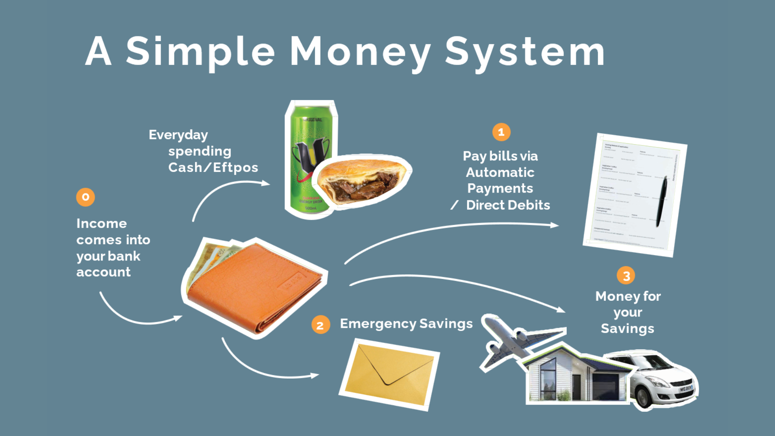

Slide 11
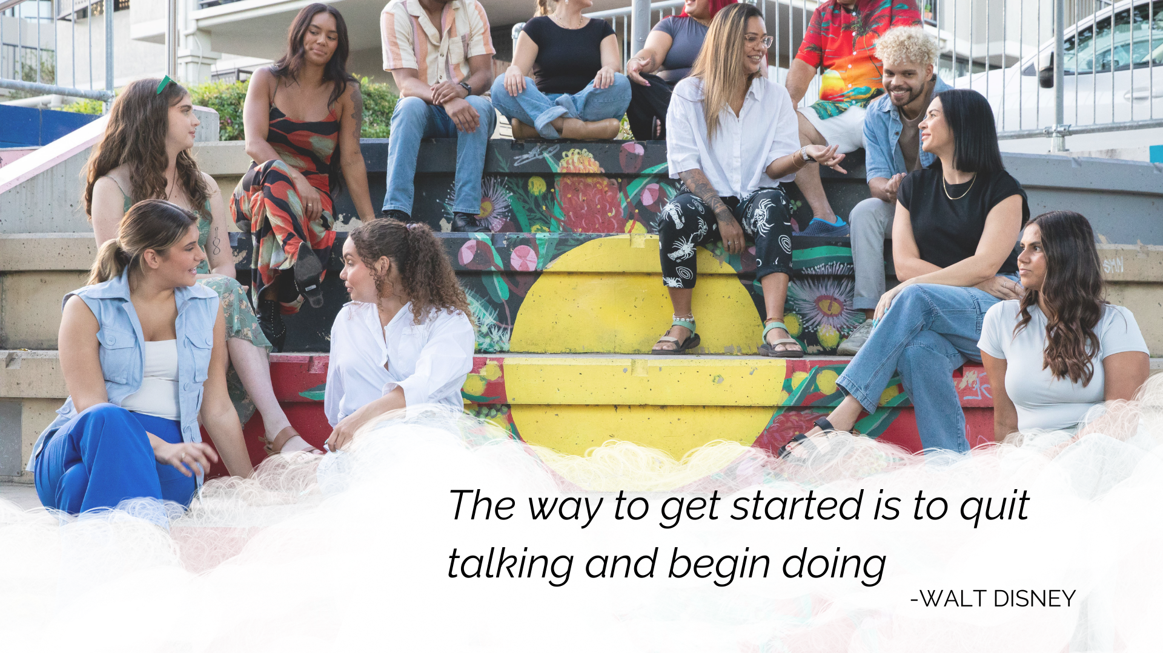

Slide 12


Slide 13


Slide 14
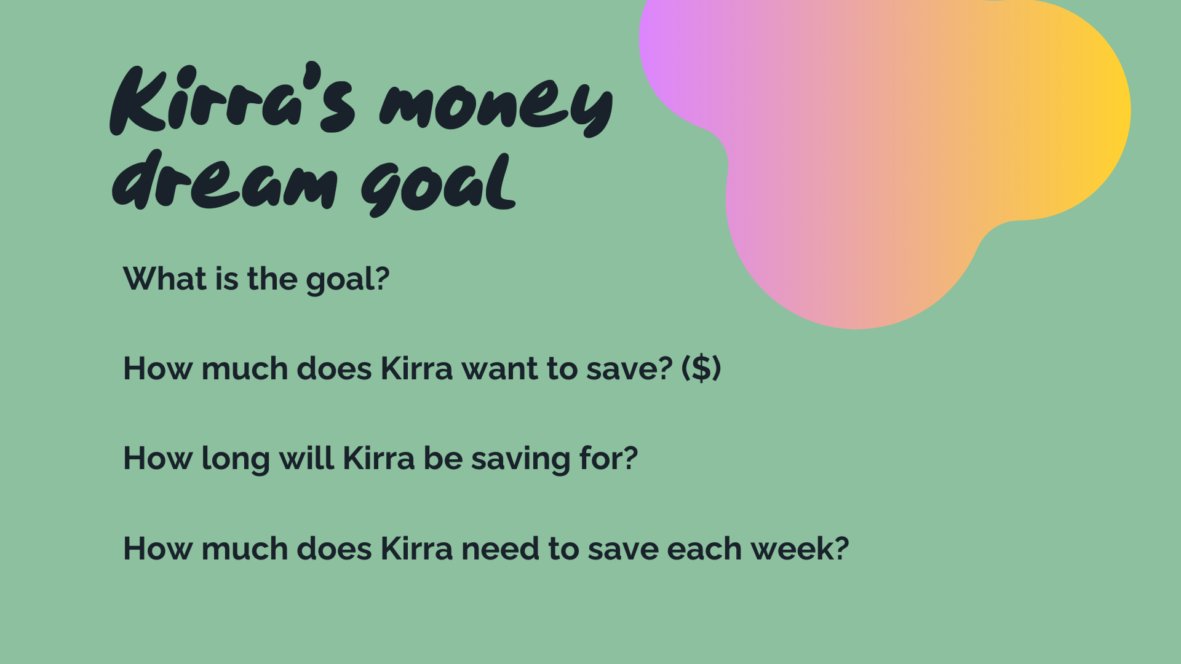

Slide 15


Slide 16
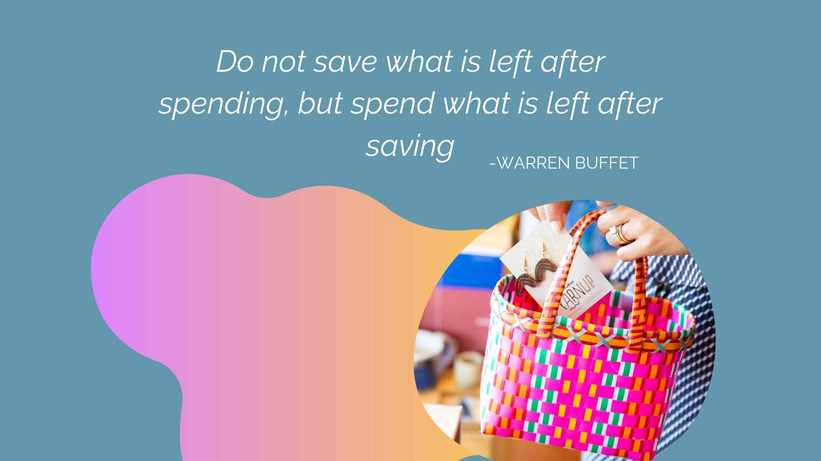

Slide 17
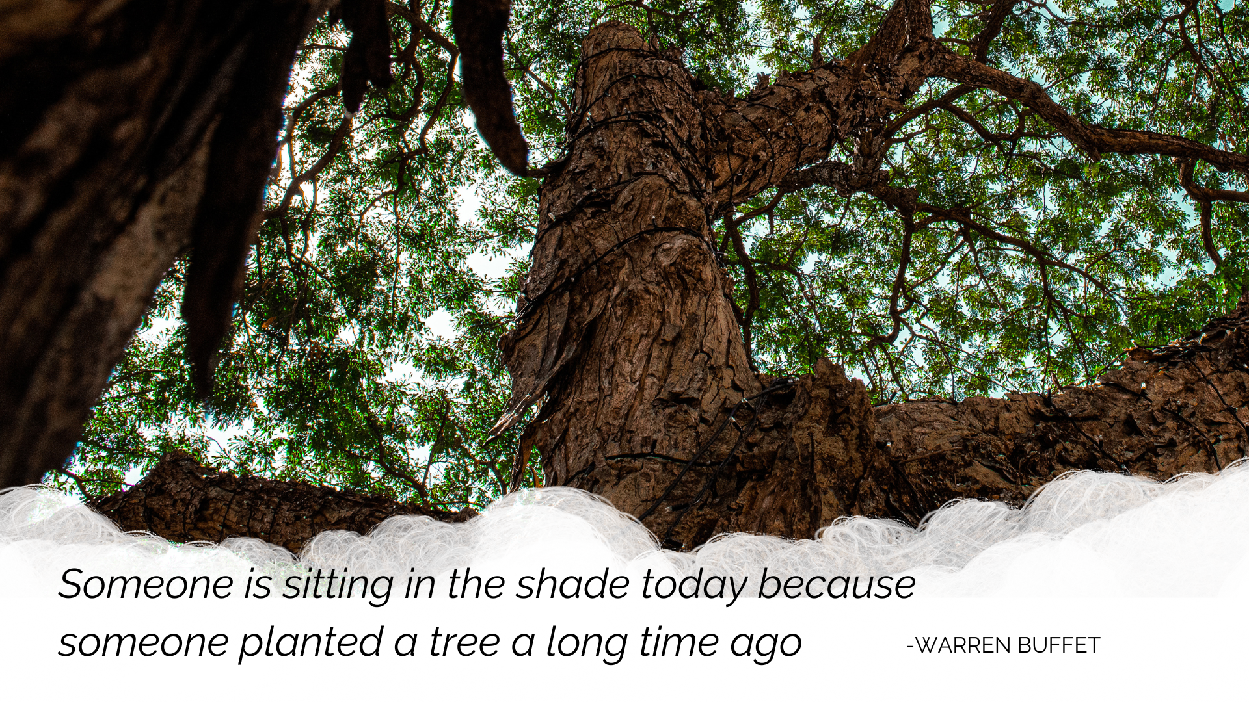

Slide 18
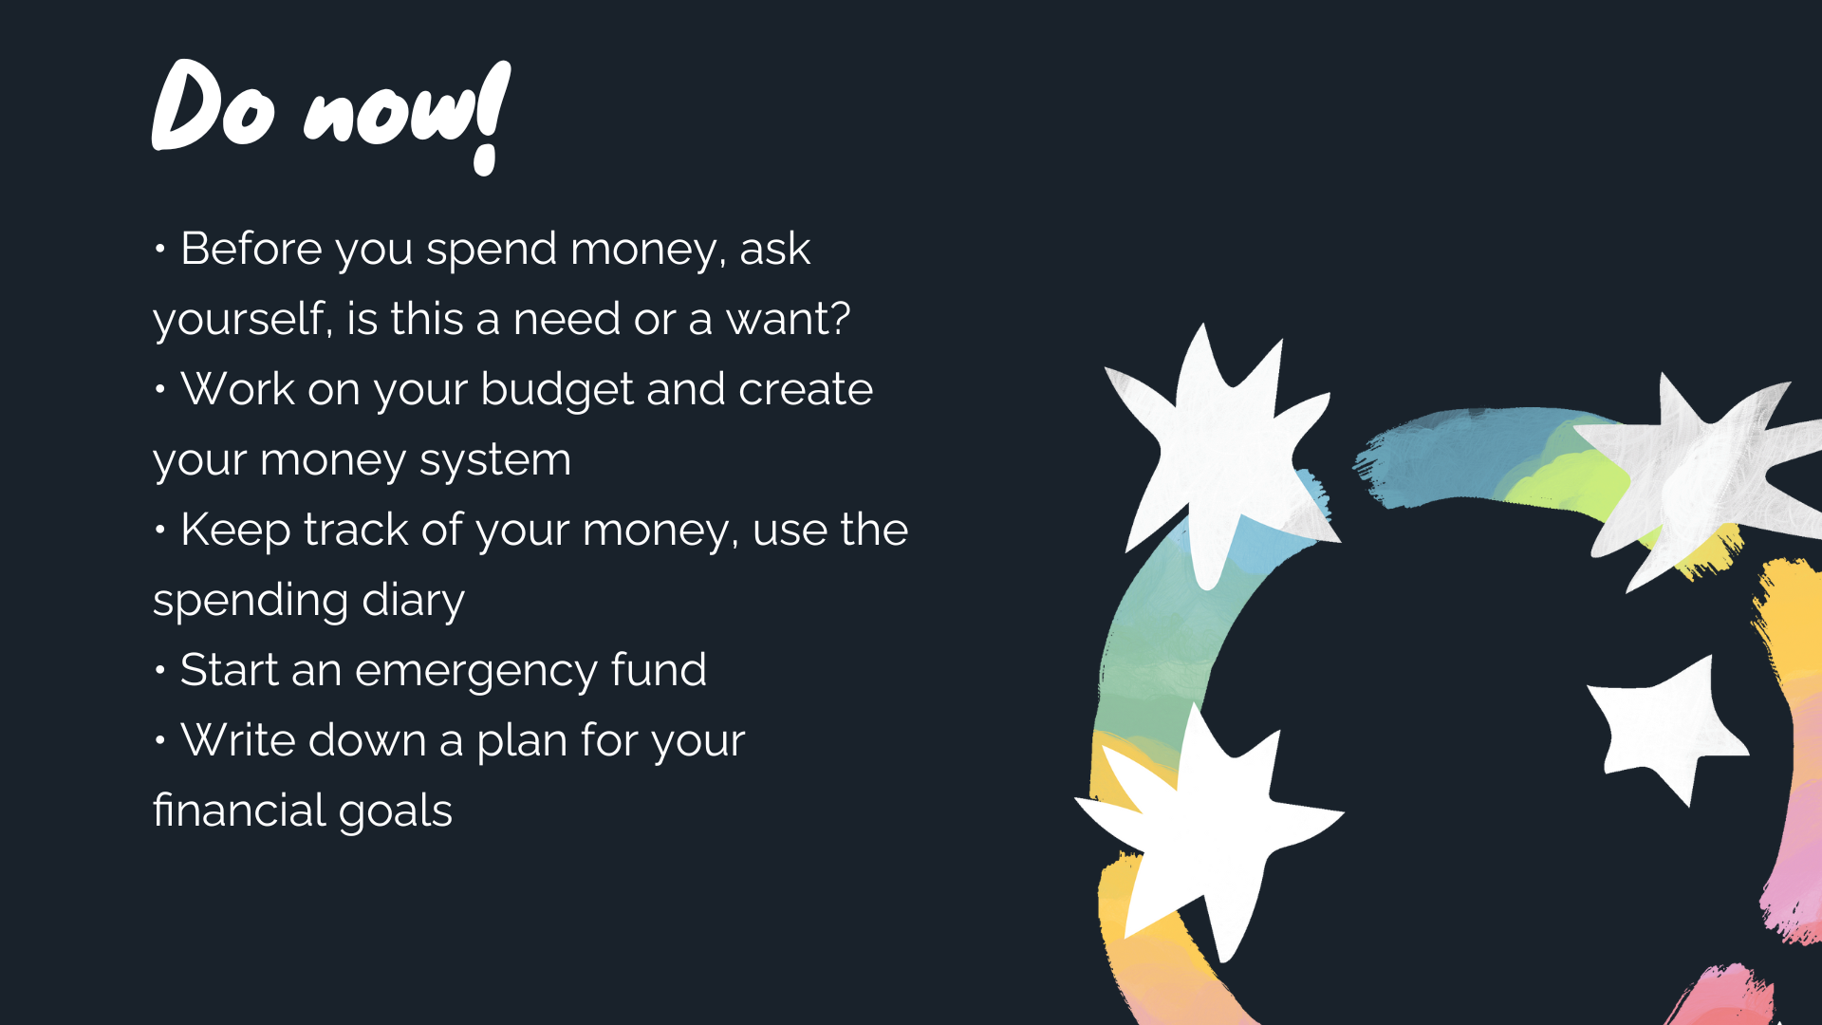

Slide 19
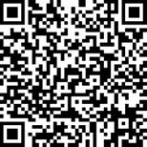
Survey
www.surveymonkey.com/r/7RJNMQK

